Slide 1

BACHELOR OF SCIENCE
IN
MATHEMATICS
DEPARTMENT OF MATHEMATICS
CARDAMOM PLANTER’S ASSOCIATION COLLGE OF ARTS & SCIENCE
BODINAYAKANUR THENI-625513
MADURAI KAMARAJAR UNIVERSITY.

Slide 2

A DATA-DRIVEN
EXPLORATION OF APPLE’S IPHONE IMPACT IN INDIA.
SUBMITTED BY,
A.RUTHRA BALA C369728CDCBFF338940465BF0528B8B2
N.SEETHA 6A701415EA5F27090B64AC04AA4ED25A
M.SYED SIFANA 195D9A49F05CA7794FA41B9460F52545
K.ASHOK 73579D2BFA17B6D9F3842985C16C719
GUIDED BY,
Mrs. R.Rohini, Ph.D.,
Assistant professor of Mathematics
PG &Research Department of Mathematics
C.P.A.College Bodinayakanur.

Slide 3
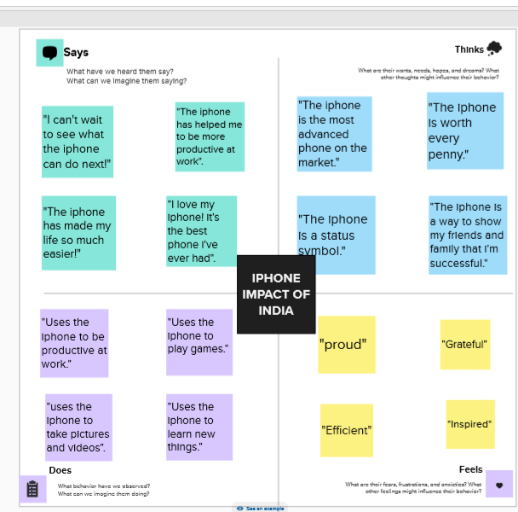

Slide 4
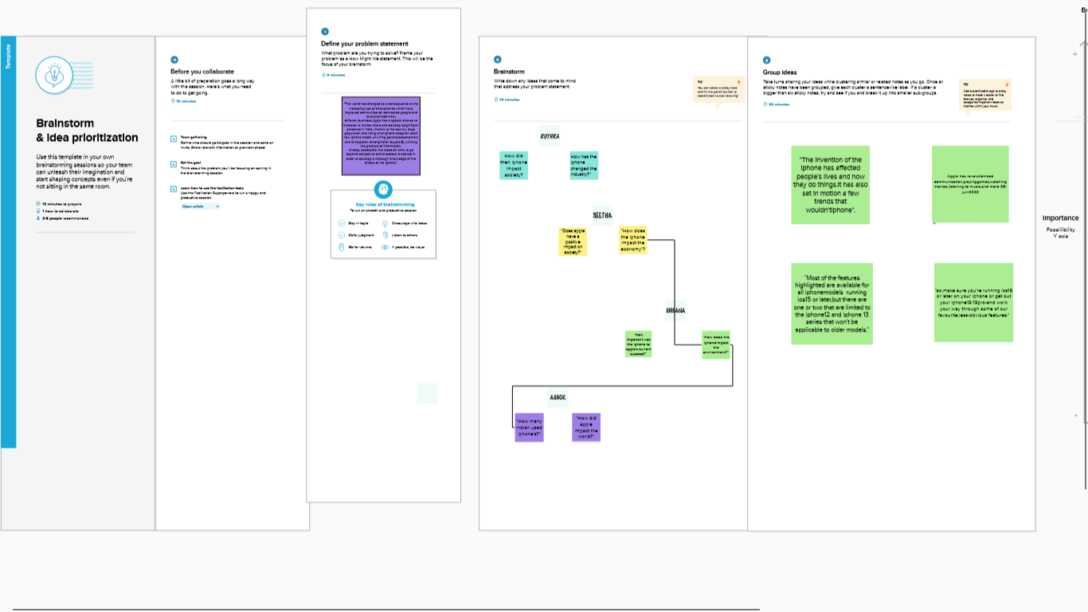

Slide 5
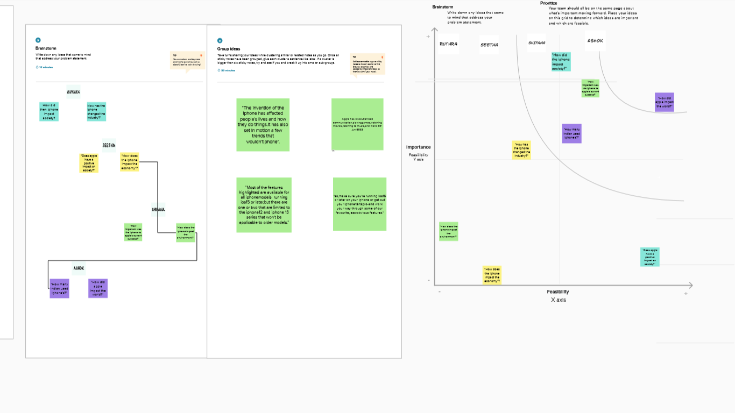

Slide 6
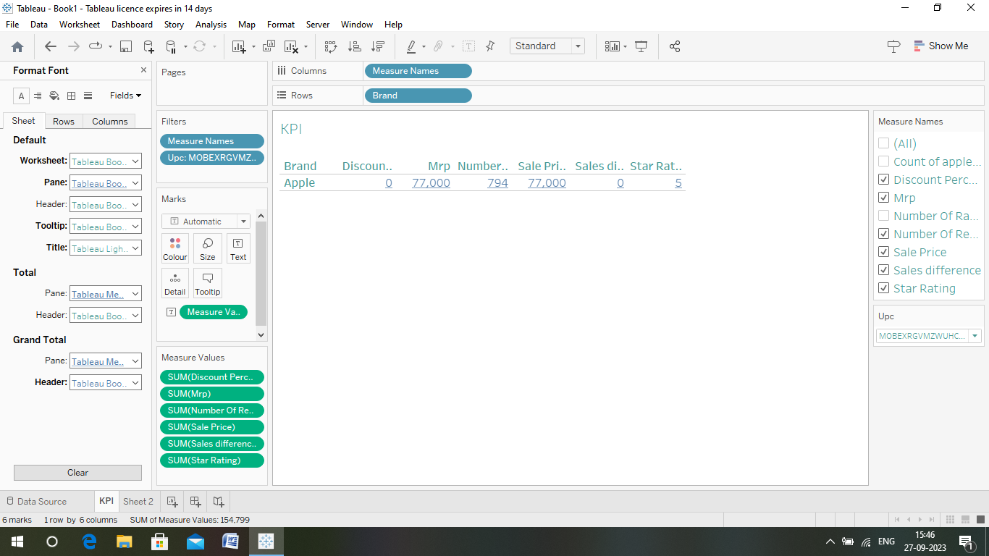

Slide 7
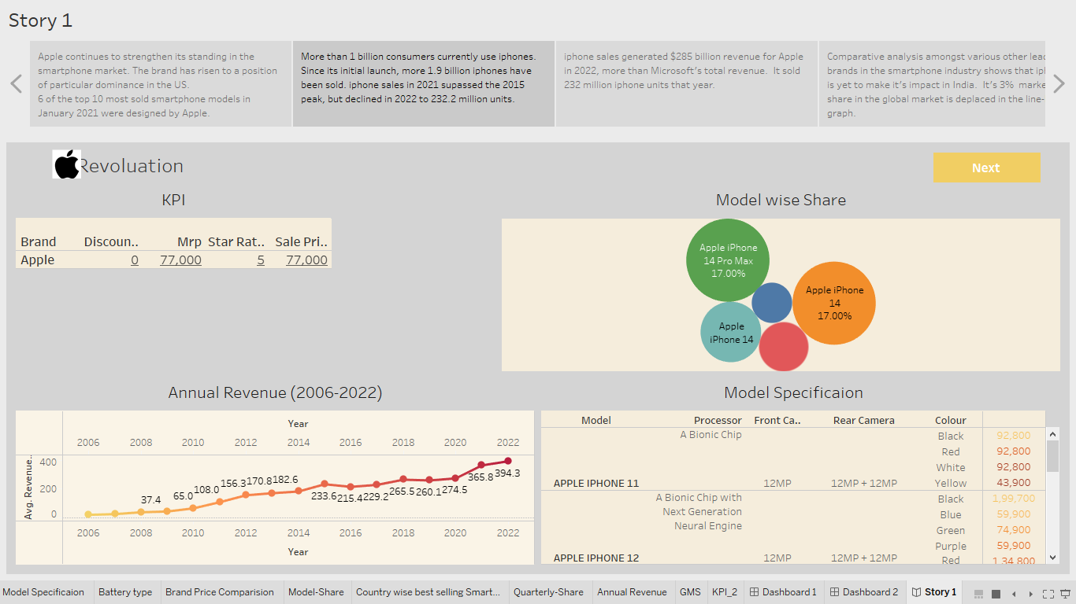

Slide 8
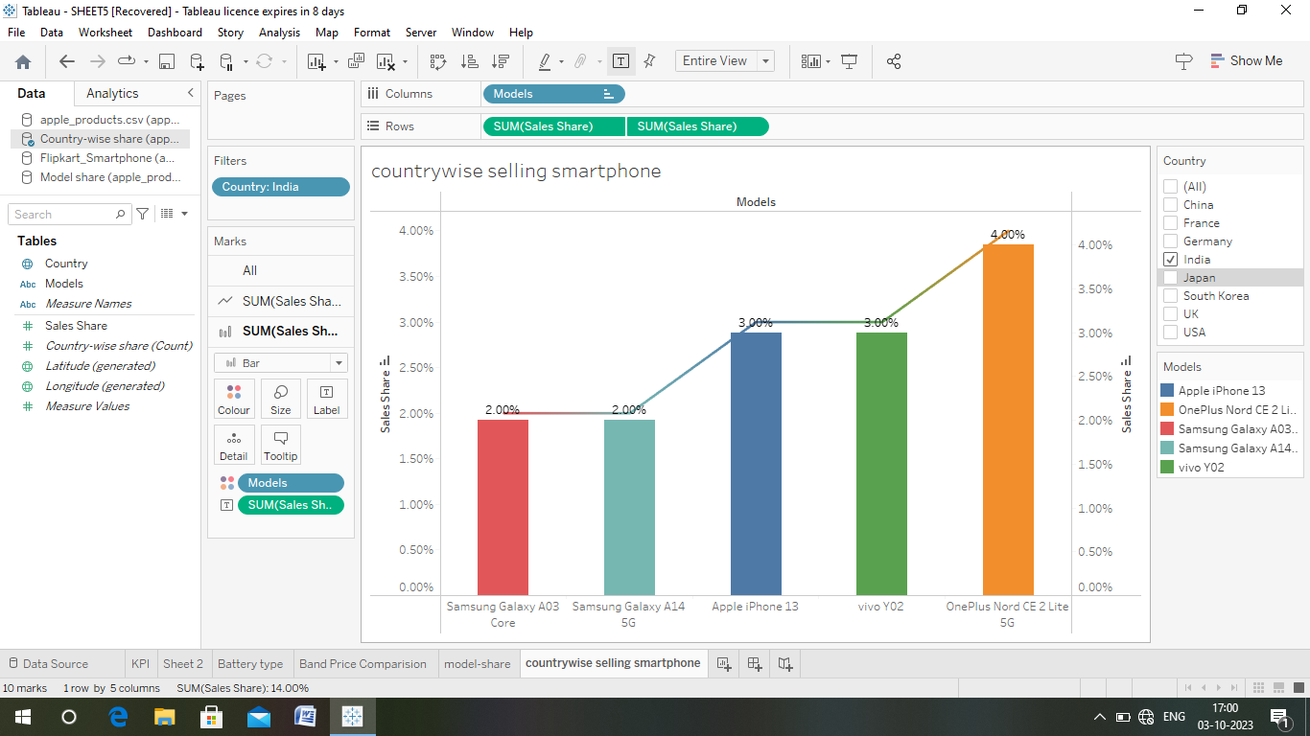

Slide 9
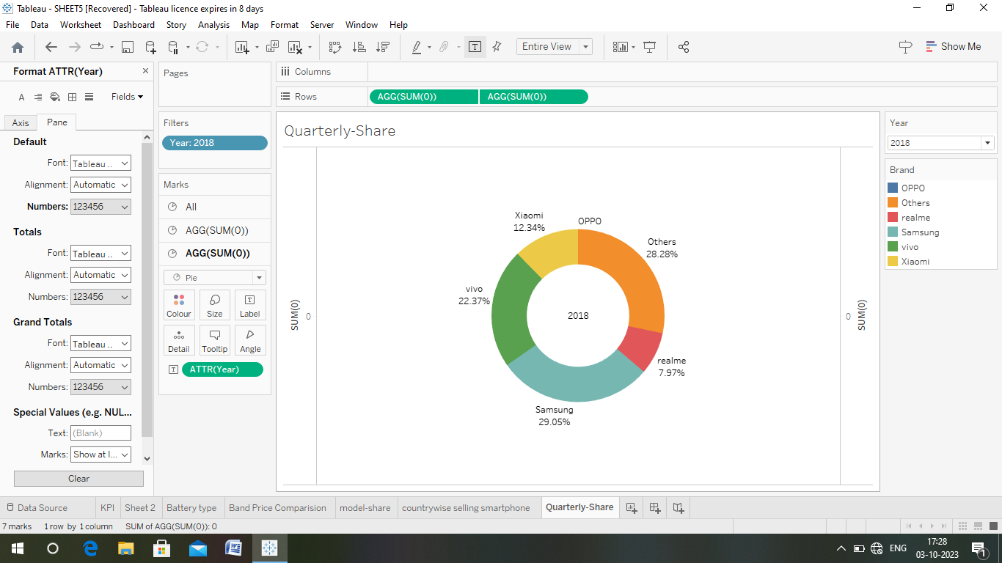

Slide 10
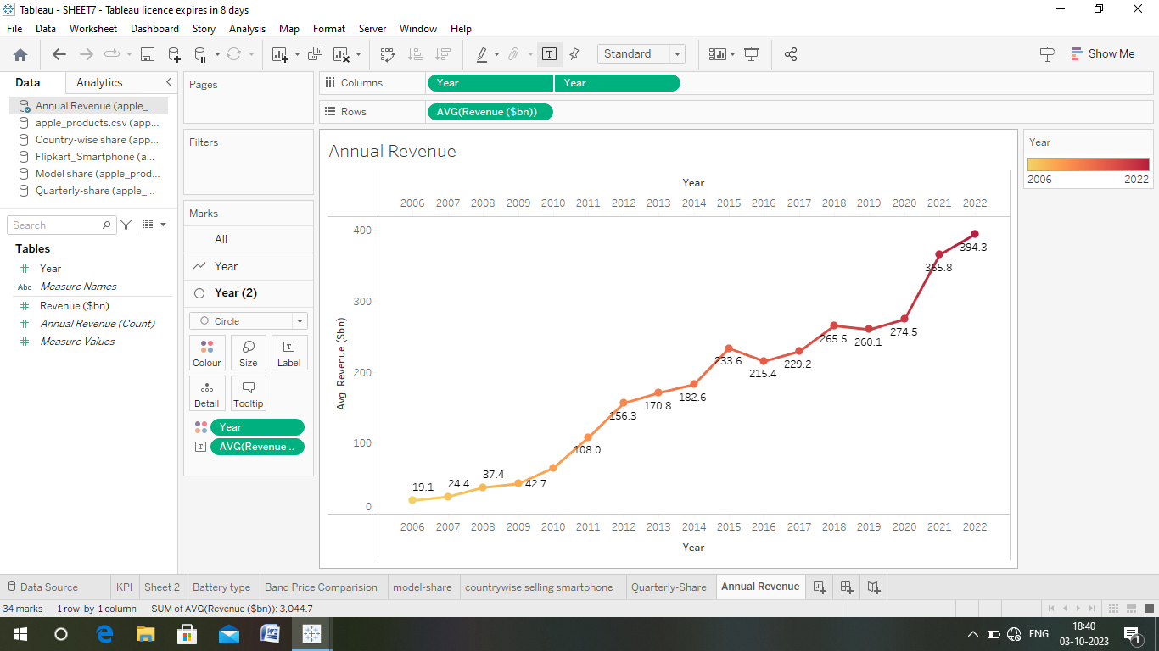

Slide 11
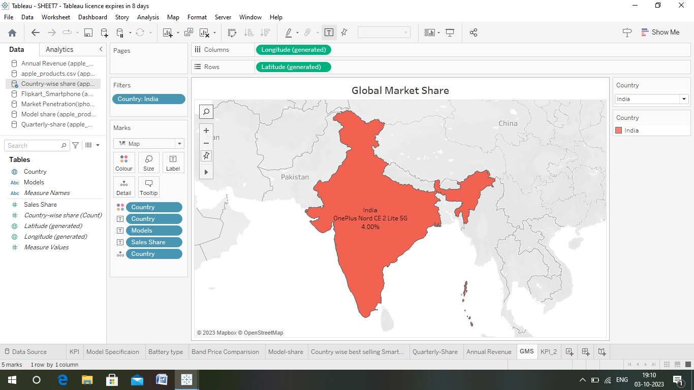

Slide 12
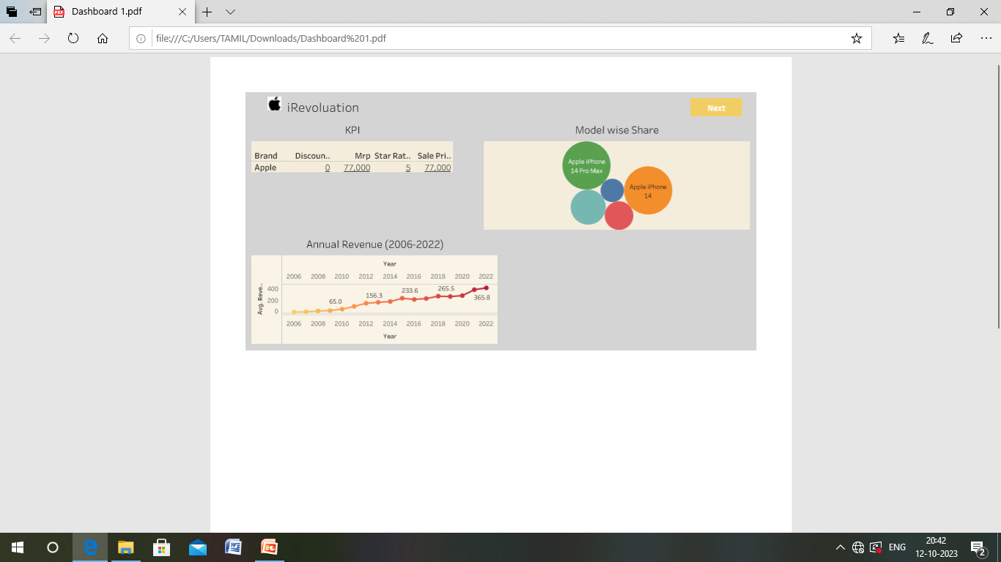

Slide 13
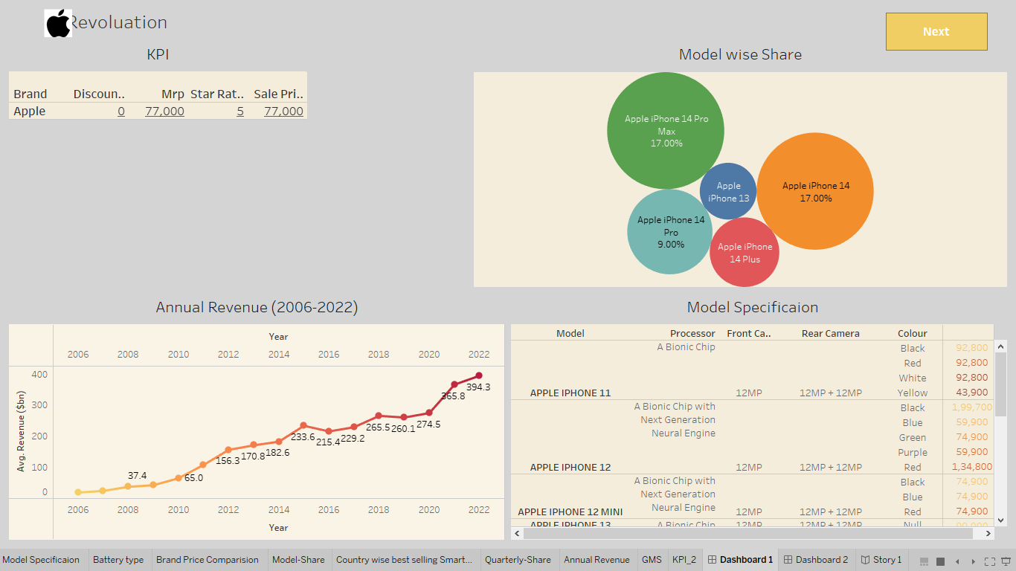

Slide 14
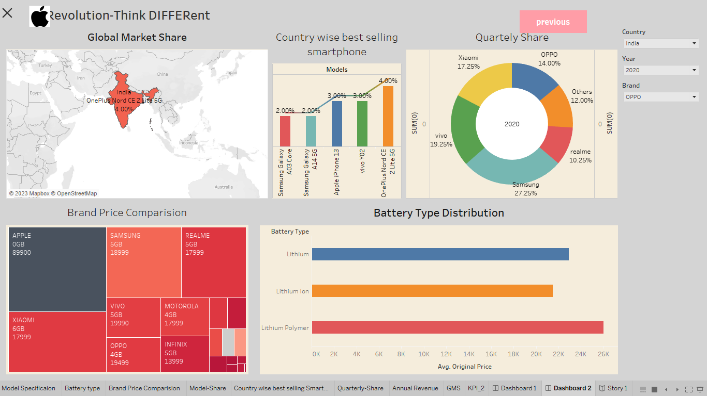

Slide 15


